Slide 1
Video Processing Project
Submitted By:
Daniel Mor - 305468340
Brian Gordon - 324397892

Slide 2
Video stabilization overview
On this part in order to stabilize the video we used an algorithm based on optical flow principals (as learned in class).
The algorithm performs the following procedure:
For each frame we find points of interest using “Harris Corner Detector” (cv2.goodFeaturesToTrack)
Calculate optimal projective transformations which describe best the transformations between frame and it’s next frame. (We chose projective transformation since 2D affine transformation wasn’t enough to describe the motion in the video, for this step we used cv2.calcOpticalFlowPyrLK and cv2.findHomography functions)
We smooth the transformations using Moving Average filter in order to reduce noise and make transitions smoother.
Finally, we create our stabilized video warping each frame using the smoothed transformations. (cv2.warpPerspective)

Slide 3
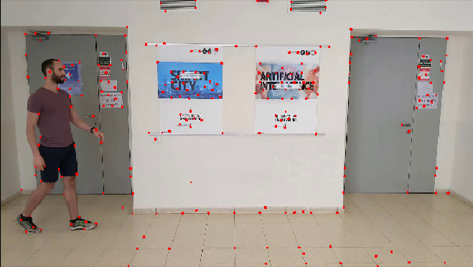
Video stabilization
Points of interest using Harris Corner Detector

Slide 4
Background subtraction
During our project we work with 2 different approaches for the background subtraction part.
In the first approach we slightly overfit since we finished the whole project before the overfit instructions were redefined. Yet, even thought our final code is not using this approach, we find it important to elaborate on this approach since we rely on its main prinicipals at the second approach.
In the 2nd approach we do not overfit and we get even better perfomance both in terms of background subtraction and time complexitiy.

Slide 5
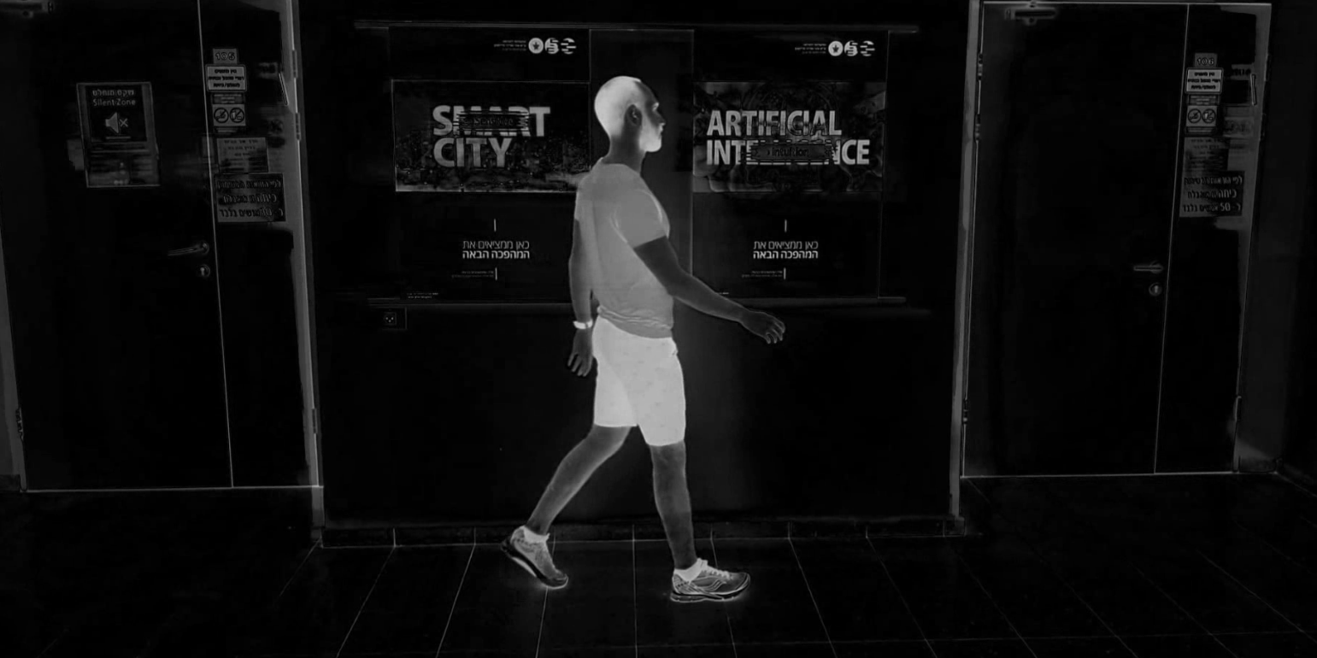
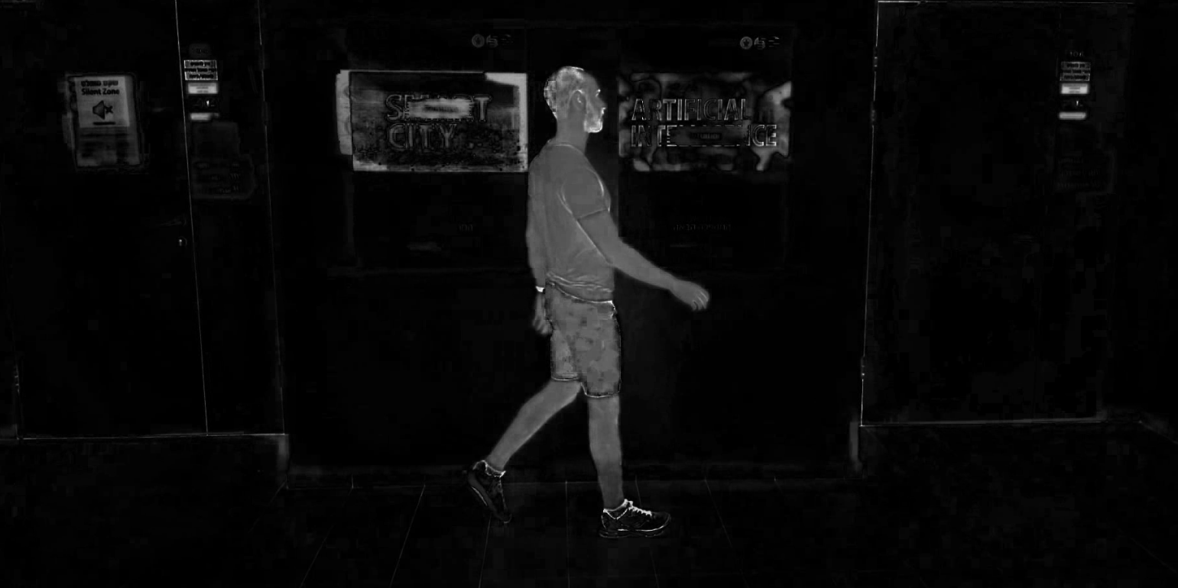
BACKGROUND subtraction - first approach
On this part in order to subtract the background we followed this procedure:
For initial filtering we analyzed different color spaces and their medians across time. The idea was to define foreground pixels to be the pixels that their intensity values are higher than their median intensity.
We find that using HSV color space and applying median filter as described on the S & V channels results as a decent initial filtering.
V channel – Diff from median
S channel – Diff from median

Slide 6
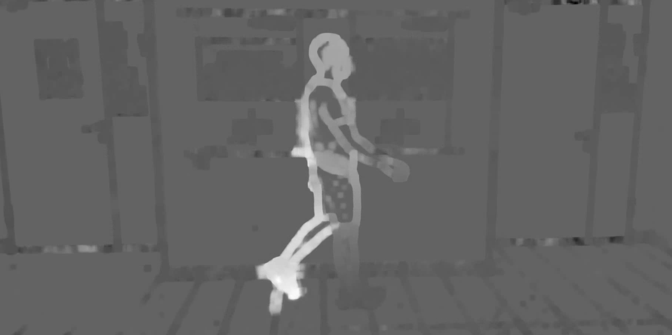
BACKGROUND subtraction - first approach
For further filtering we tried to differentiate the person from the background based on it’s horizontal velocity. We computed for each pixel and frame it’s optical flow, we then tried to cluster the pixels in to 2 clusters based on their horizontal velocity (using K-means algorithm).
Unfortunately, we got poor results both in terms of time complexity and cluster performance as shown in the following picture.
Horizontal velocity frame.
As we can see it’s hard to make a good separation on specific parts of the body (i.e. right foot) since different
parts of the body change their velocity frequently in the video

Slide 7
BACKGROUND subtraction - first approach
After we failed to differentiate the person from background using clustering based on horizontal velocity, we tried to differentiate the person by calculating a representative pdf both for the person and the background following this procedure:
(Note: In this part we did some kind of overfitting (But as we said this is not our final approach)
- We chose some frame after S&V median filtering as a representative mask
- We eroded dramatically the mask in order to get color samples from the person only.
We used those samples in order to build a pdf representation of the person (Using gaussian KDE), the same process has been done for the background.
After having both pdfs we computed for each pixel in each frame it’s probability of being a foreground or background pixel.
Pixel was defined as a foreground pixel if it’s foreground probability was higher than it’s background probability. (Naïve base) (Note: in order to optimize the performance we used memoization. Since probability is defined only by pixel color, it’s sufficient to calculate each color probability once. So instead of calculating probabilities for 2M pixels in each frame, we computed only 150K color values).
As known using the described approach, the outcome will always be noisy. In order to fix the noise we used morphological operations and contour. Results are shown at the next slides.

Slide 8
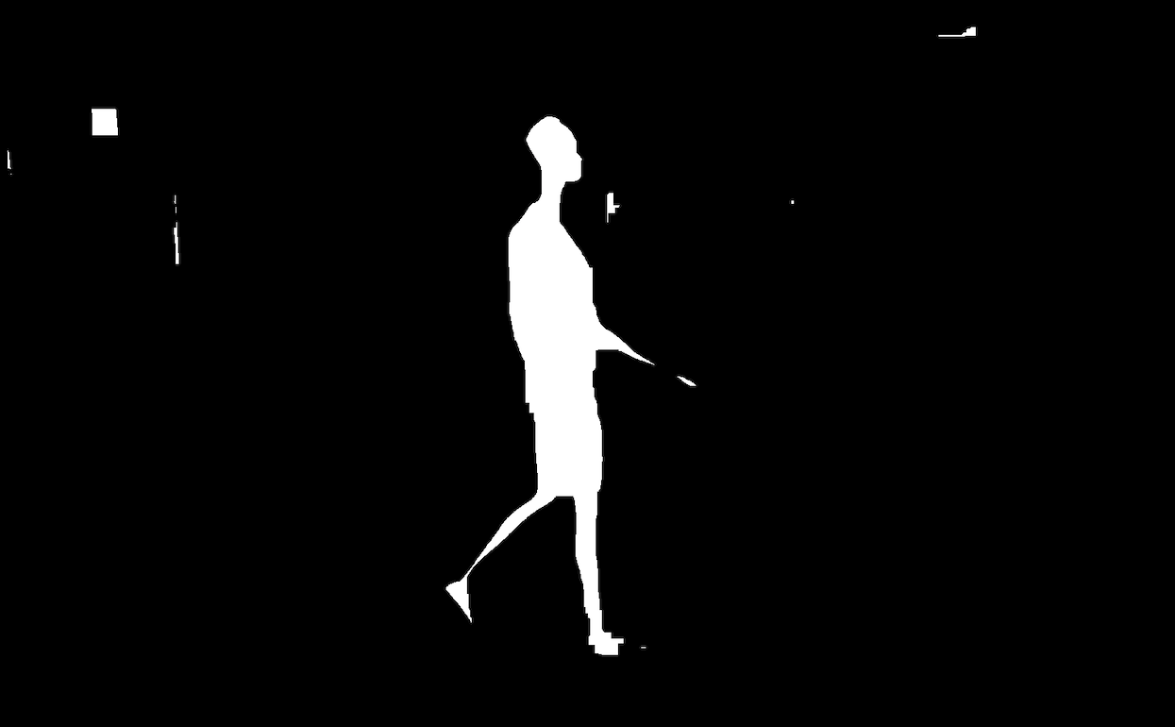
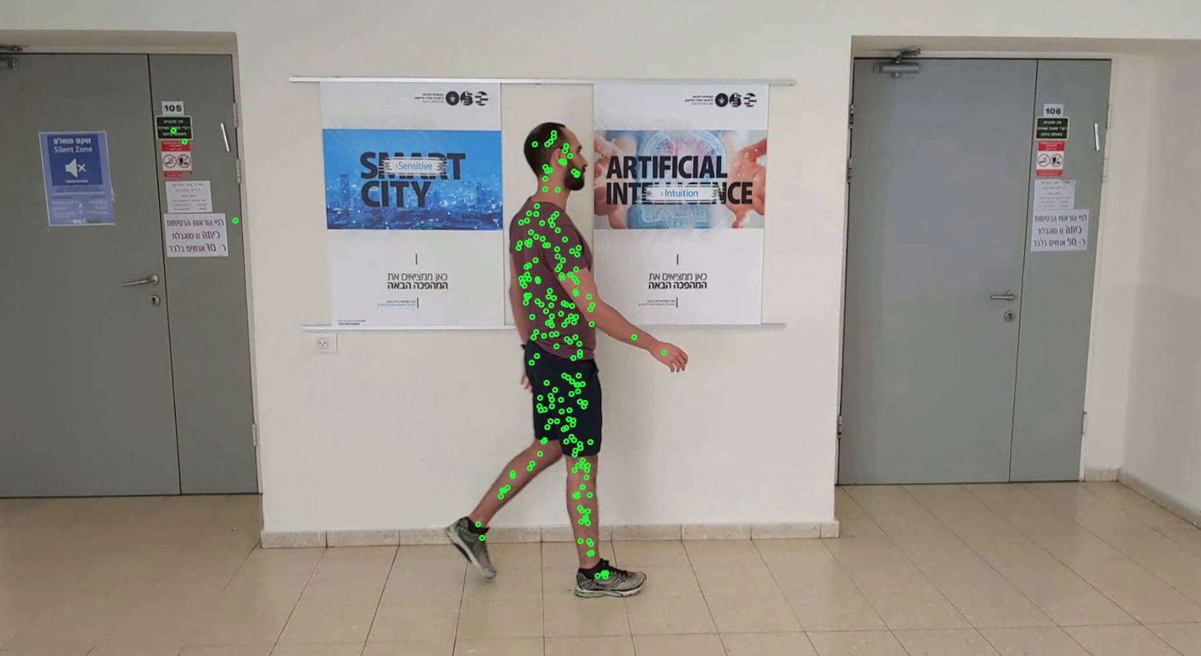
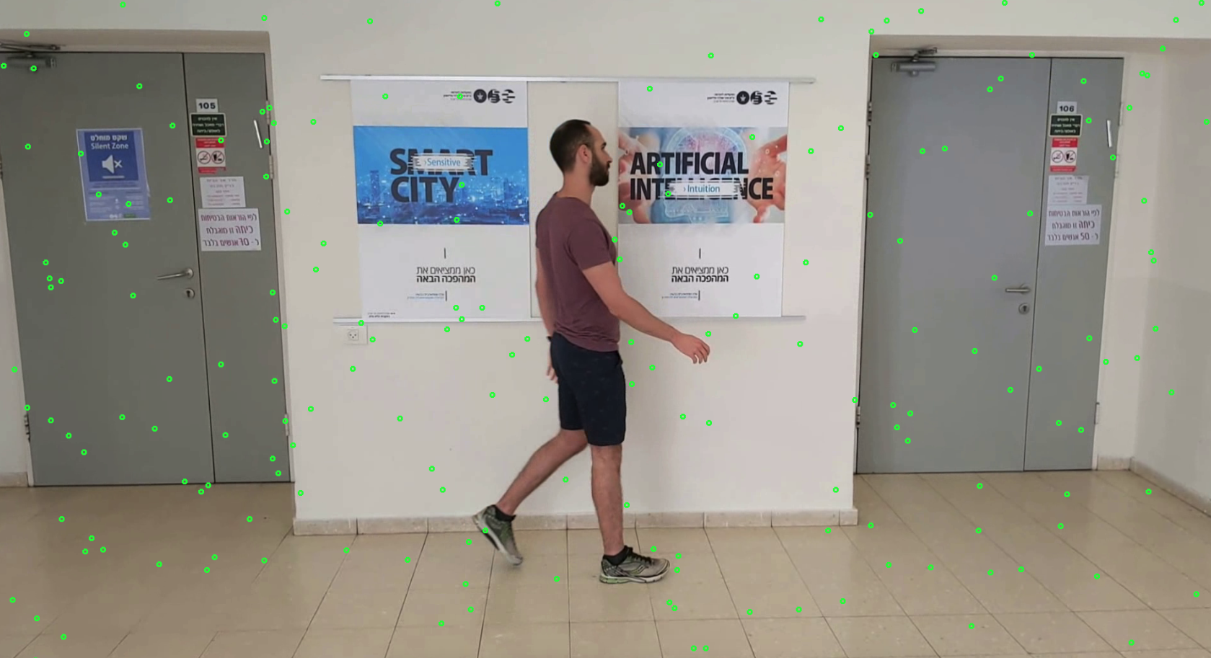
Mask for sampling person and background colors
for building representing pdfs
Color samples taken for building person pdf
Color samples taken for building background pdf

Slide 9
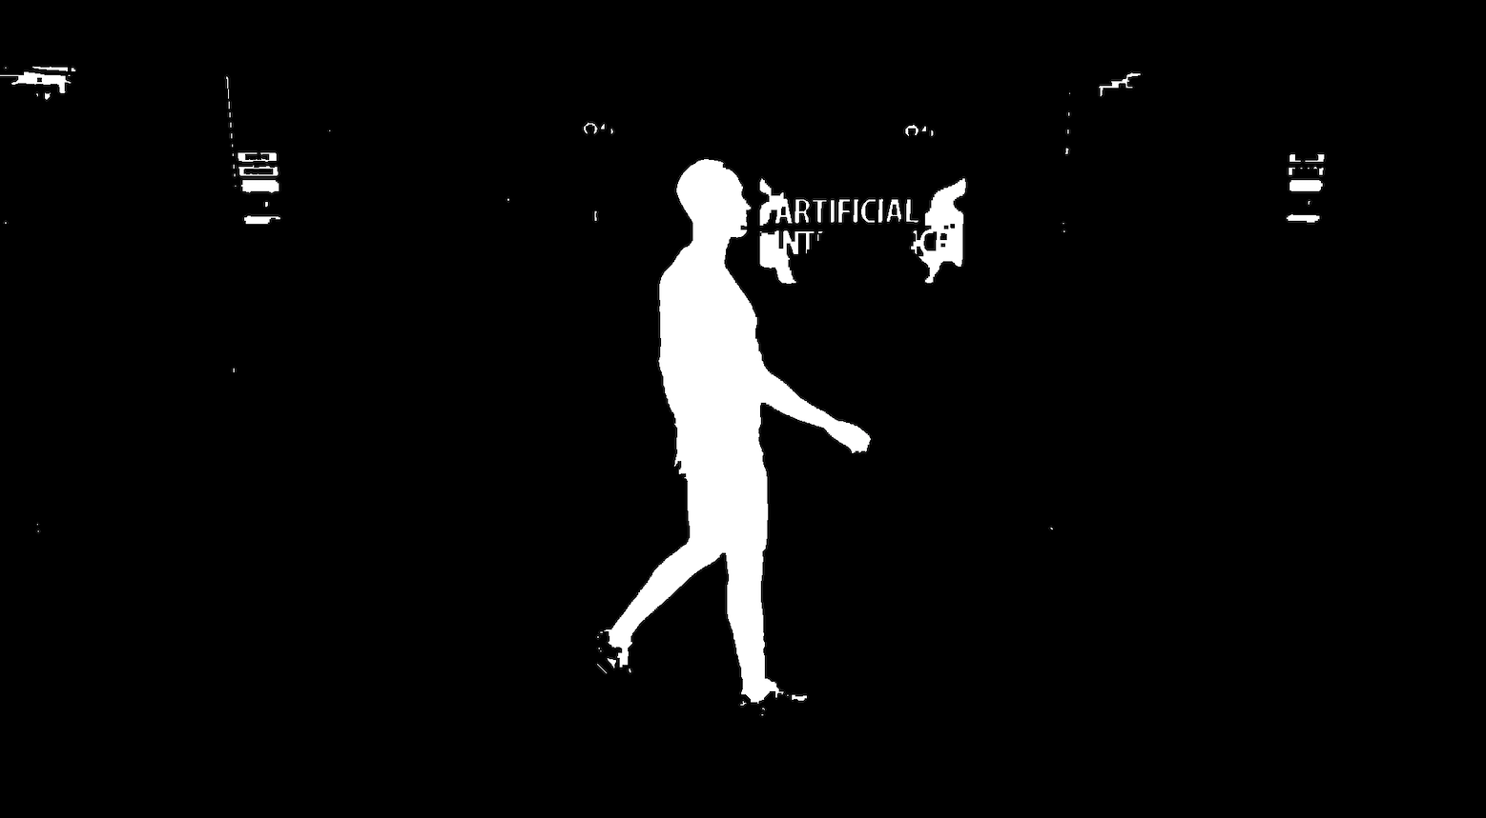
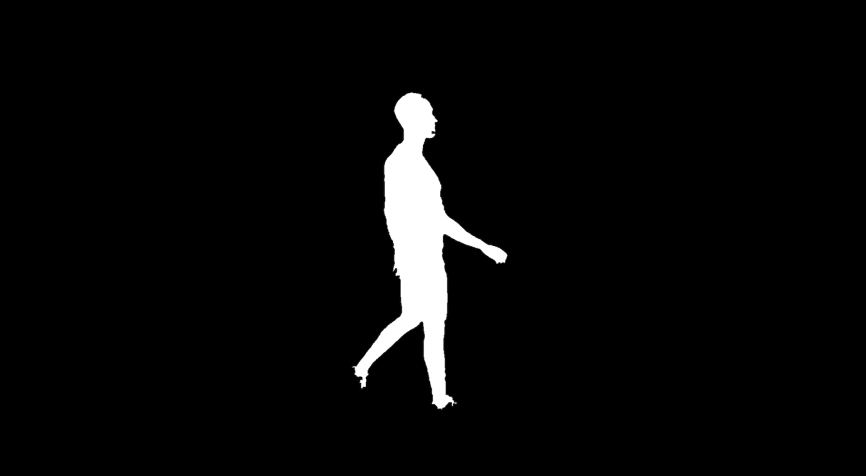
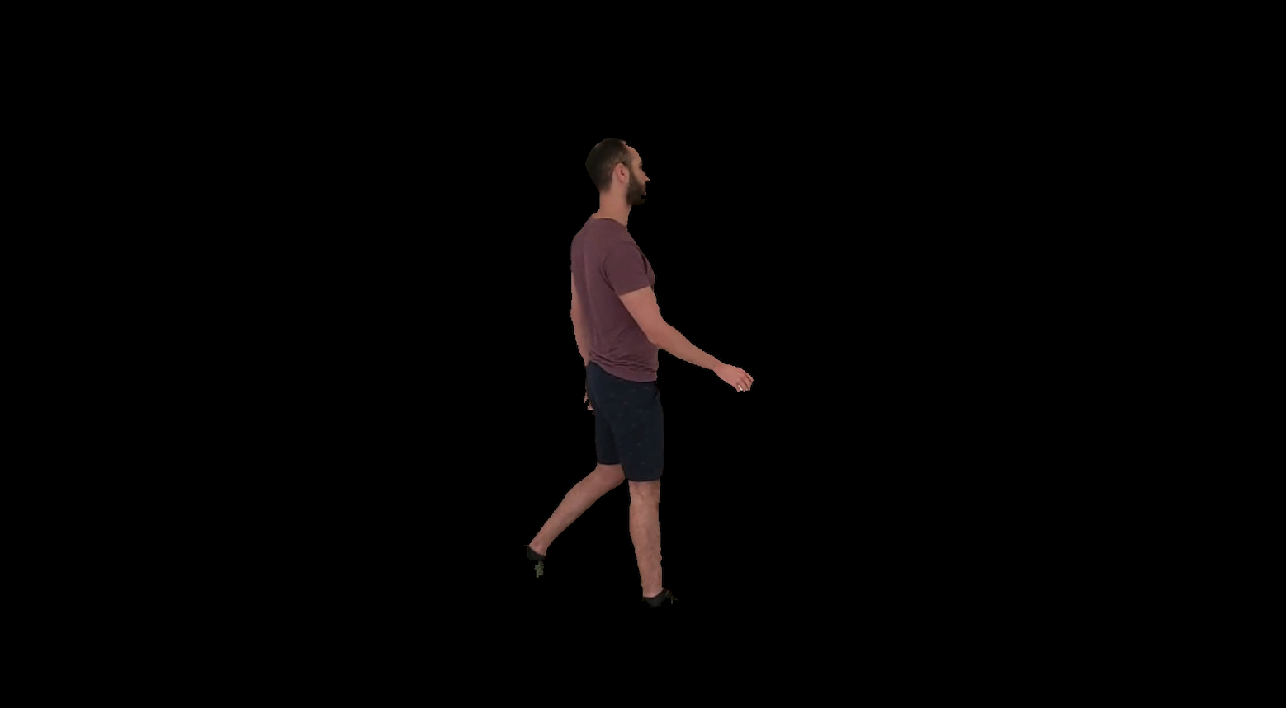
Mask received from pdfs
and morphological operations
Mask received after contour separation
Applying mask on frame.
Notice that we lost the shoes

Slide 10
BACKGROUND subtraction - first approach shoes RESTORATION
As seen in the previous slide, by using the contour approach we have lost the shoes, so this part is mainly focused on shoes restoration.
Our assumption was that we have lost the shoes at the previous step, since there were not enough color samples from the shoes while building the foreground pdf.
We tried two different approaches to restore the shoes:
Approach A:
Using median filtering on green channel, unfortunately we got poor results using this approach.
Approach B:
Main idea for this approach was to build a “shoe specialist classifier” that is able to differentiate the shoes from their background and then connect the shoes back to the person mask.
So, instead sampling from the whole body, we focused our algorithm to sample only from the shoes while build their representative pdf. The same process was done to build the background pdf. (i.e. the pdfs were built only from the lower part of the image).

Slide 11
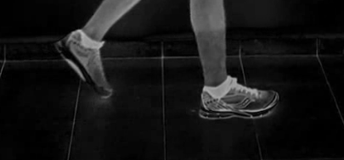
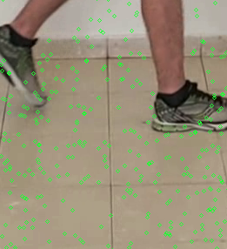
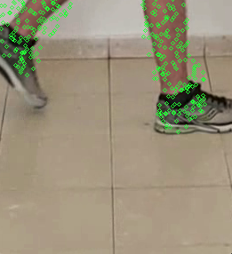
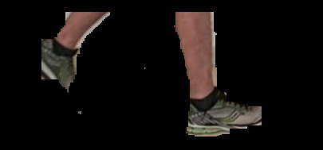
Green channel median filtering
Color samples taken
for building shoes background pdf
Color samples taken
for building shoes foreground pdf
Final result for shoes restoration

Slide 12
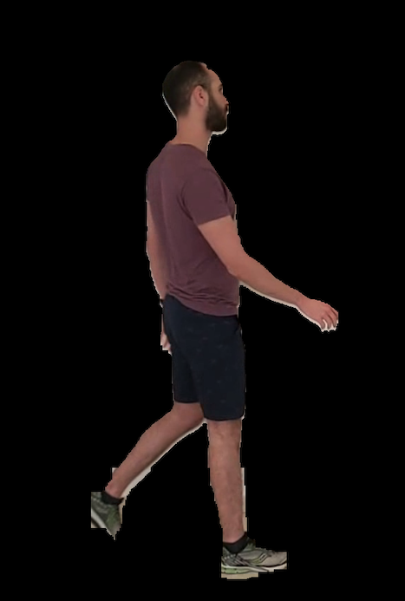
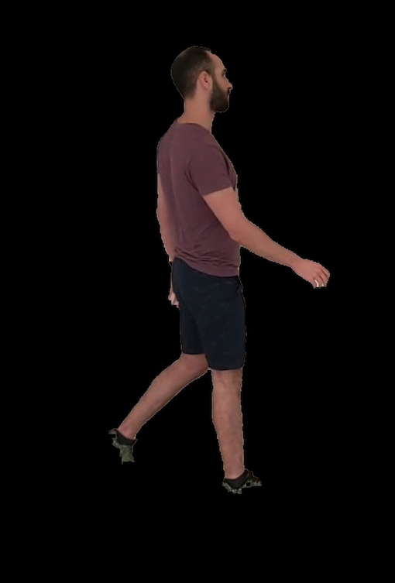
BACKGROUND subtraction - first approach shoes RESTORATION
BEFORE
AFTER

Slide 13
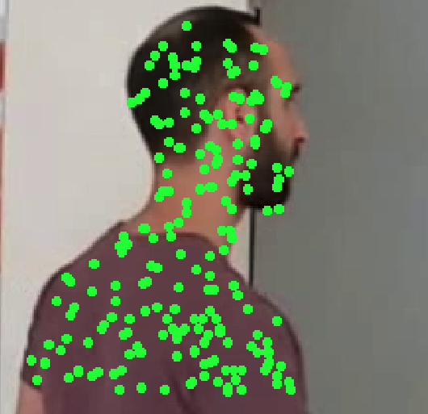
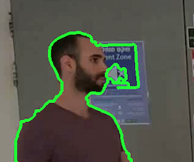
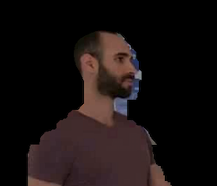
BACKGROUND subtraction - first approach face better classifier
After achieving decent results for the shoes using a “shoes specialist classifier” we decided to use the same approach in order to differentiate better the person’s face from it’s background.
Color samples taken for building
shoulders and face foreground pdf
BEFORE
(Marked in green)
AFTER

Slide 14
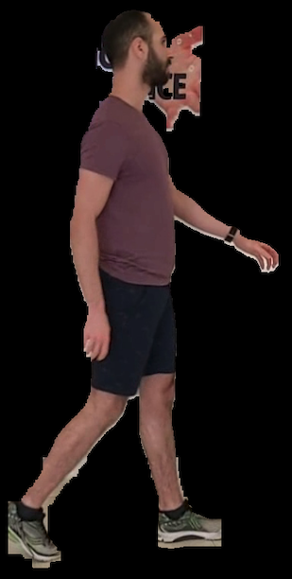
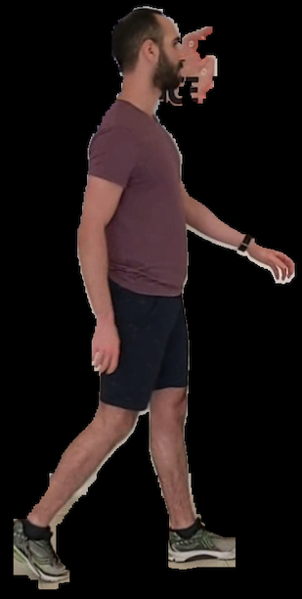
BACKGROUND subtraction - first approach face better classifier – FAILURE CASE
The main reason why this classifier failed is because the person’s color and the background’s sign color is pretty much the same, even while trying using narrow bandwidth we have never been able to remove the sign
BEFORE
AFTER

Slide 15
BACKGROUND subtraction – FIRST APPROACH CONS SUMMARY
Cons of this approach are:
In order to learn the pdf for foreground and background we slightly overfit since we chose a specific frame to get statistics from.
We further overfit while trying to learn shoes pdf and separate them from the background (in order to get good performance we had to perform a custom cuts on a specific frame in order to achieve a good representation of the shoes. (The same is relevant for the face restoration)
Overall, the background subtraction part took almost an hour.
In the second approach we managed to achieve even better performance without overfit and the algorithm for the background subtraction part takes only 10 minutes.

Slide 16
BACKGROUND subtraction - SECOND approach
The second approach for background subtraction is the following procedure:
We replaced the median filtering on S&V channels from first approach with a more sophisticated way using cv2 BackgroundSubtractorKNN, since this algorithm learns online how to differentiate background and foreground we feed the algorithm the full video 8 times to achieve decent initial results. Instead of performing simple morphological ‘close’ operation, we used a median filter in order to take advantage of the fact that the density of ‘false negatives’ on the person is higher than the density of ‘false positives’ on the background.
cv2 BackgroundSubtractorKNN initial mask
Initial mask after median and close filtering

Slide 17
BACKGROUND subtraction - SECOND approach
As in the previous approach we do learn pdfs for foreground and background but instead of focusing on a specific frame, we learn those pdfs across time. Meaning, we collect 20 color samples both for background and foreground in each frame that way we managed to not overfit like we did before. A good side of effect was that the performance could now be highly optimized using memoization since our foreground and background pdfs stay the same all the time.
For further improvement in terms of time complexity, instead of computing the probabilities for each pixel at each frame both for foreground and background, we calculated the mean location at both axes X,Y to get an initial guess of person’s location and around this mean location we opened a window with size of 1000x500 and the process was done only on this small window, as the rest of the image will be for sure background.
Another improvement from first approach is instead of collecting colors for shoes just from one customized frame, we also collect color samples for the shoes over time. Avoiding overfit here as well.

Slide 18
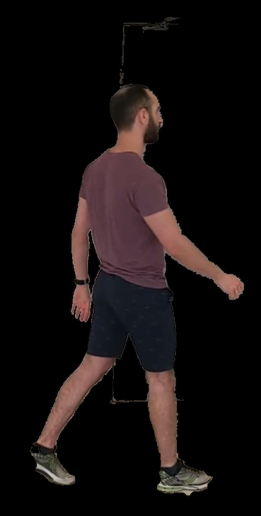
BACKGROUND subtraction - SECOND approach
After applying shoes and body pdf
After applying shoes and body pdf
Sign still appears as foreground

Slide 19
BACKGROUND subtraction - SECOND approach
Face classifier
As showed in last slide, we can see that in large portion of the frames, the signs are still recognized as foreground.
- In order to differentiate face from signs, as described in the first approach we tried to find a better pdf that is specialized on face detection. To avoid overfit we also learned this classifier across time and to get good results we had to use narrow bandwith.
To sample only face colors we used our previous results masks and perform morphological operations to eliminate the sign as much as possible.
The idea was to learn KDEs as in the first approach but in order to avoid overfit we learned across time.

Slide 20
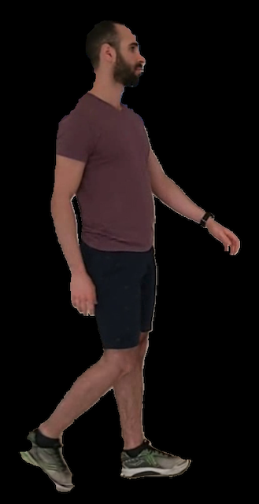
BACKGROUND subtraction - SECOND approach
Face classifier
Before face classifier
Sign still appears as foreground
After face classifier
Sign eliminated

Slide 21







MATTING
$$D_{f}\left(x\right)≈D_{b}(x)$$
$$α\left(x\right)=\frac{W_{f}\left(x\right)}{W_{f}\left(x\right)+W_{b}(x)}$$
$$\left|\frac{D_{f}\left(x\right)−D_{b}\left(x\right)}{D_{f}\left(x\right)+D_{b}\left(x\right)}\right|<ε$$
$$Matted\left(x\right)=α\left(x\right)∙F\left(x\right)+\left(1−α\left(x\right)\right)∙B(x)$$
$$W_{f}\left(x\right)=D_{f}^{−r}∙P_{f}(x)$$
$$W_{b}\left(x\right)=D_{b}^{−r}∙P_{b}(x)$$
(Note: for calculating distance maps we used GeodisTK library - geodesic2d_raster_scan function)
For the matting part we investigated more approaches than the offered implementation on course website. We tried the following changes:
For narrow band selection (undecided zone):
The implementation on the webiste suggested to find pixels that satisfies $D_{f}\left(x\right)≈D_{b}(x)$ and dilate around those pixels.
We also tried to define the narrow band as the pixels that satisfies $\left|\frac{D_{f}\left(x\right)−D_{b}\left(x\right)}{D_{f}\left(x\right)+D_{b}\left(x\right)}\right|<ε$ the idea behind this approach is to open different widths of band based on the difference between $D_{f}\left(x\right)$ and $D_{b}(x)$.
We received better results using the second approach
For the refinement part:
The implementation on the website suggested to use naïve approach using the following equation: $Matted\left(x\right)=α\left(x\right)∙F\left(x\right)+\left(1−α\left(x\right)\right)∙B(x)$
We also tried the refinement approach as Alex describe in the lecture, by solving least squares problems. Unfortunately, the improvement in the results did not justify the time complexity impact added on this approach

Slide 22
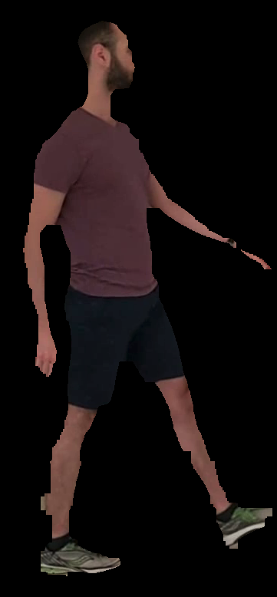
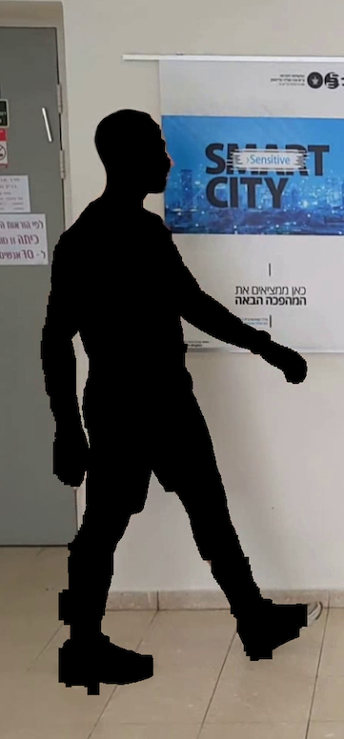
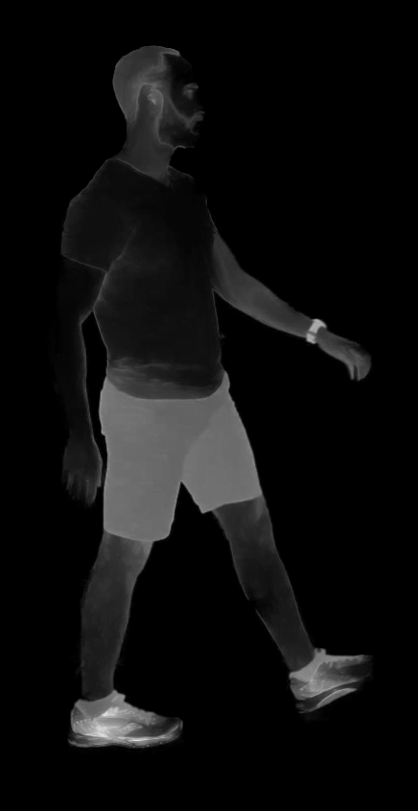
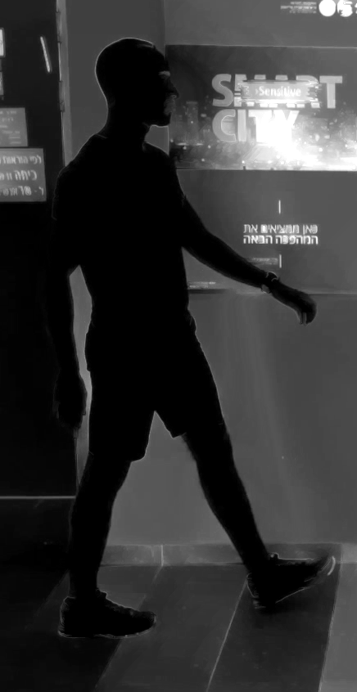


MATTING
$$Ω_{F }Scribble$$
$$Ω_{B }Scribble$$
Background dist map
Foreground dist map
Note: Scribbles for background and foreground
were automatically taken from background subtraction part

Slide 23
MATTING
Undecided zone
Alpha map
After matting

Slide 24
Refinement – Naïve implementation
Refinement – Naïve implementation
These results are here only to show that we didn’t get better visual performance by solving least squares problem in order to find best match. It can be seen there is no significant improvement, therefore we continue with the naïve implementation.
Note: These pictures are from an old version of our matting algorithm, our submitted solution achieve way better visual performance

Slide 25

Tracking – FIRST APPROACH
For the tracking part we tried 2 different implementations.
Approach A – Particle Filter (NOT SUBMITTED):
This approach is based on homework #3 and is essentially uses the particle filter learned in class.
After trying this approach we got poor results both in tracking performance and time complexity.
To accelerate the algorithm we tried to used KDE instead of histogram matching. Recall that the distance metric between two histograms in HW#3 was Bhattacharyya , we tried a different distance metric to compare two different pdfs. The new distance metric that we tried was KL-Divergence, yet we still got poor results but at least we still manged to improve time complexity.
The two fundamental cons of this approach are:
The algorithm is based mainly on histogram/pdf comparisons which fails when the boundig box selected by the user contains a lot of background pixels.
This algorithm requires a prior that describes a general motion of the object, which we wish to avoid. (overfitting $μ$ and $σ$parameters)

Slide 26
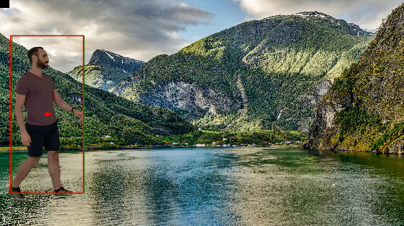
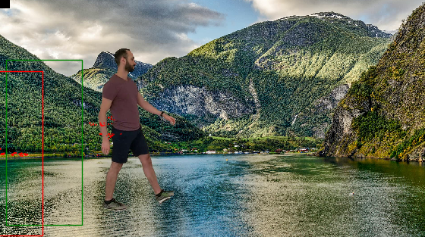
Tracking – FIRST APPROACH
Tracking using particle filter – Failure example

Slide 27
Tracking – second APPROACH
Approach B – MeanShift (Submitted):
This approach is based on MeanShift algorithm learned in class.
In order to get better performance we decided to apply the tracker on S&V channels – as after analyzing the different colors spaces, we found these channel provide the best results.
Comparing time complexity between both approaches, this approach takes around a minute to process the entire video, whereas particle filter process the entire video in about 10 minutes after KDE boosting.
MeanShift is not vulnerable to the bounding box selection, while particle filter is.
For this algorithm we used cv2.meanShift & cv2. calcBackProject
The calcBackProject function computes probability of each element value in respect with the empirical probability distribution represented by the histogram.

Slide 28
Tracking – second APPROACH
Default selection
Default selection result
Note: As described in left picture, the user can choose it’s own bounding box to track
or press ‘ESC’ key for default selection

Slide 29
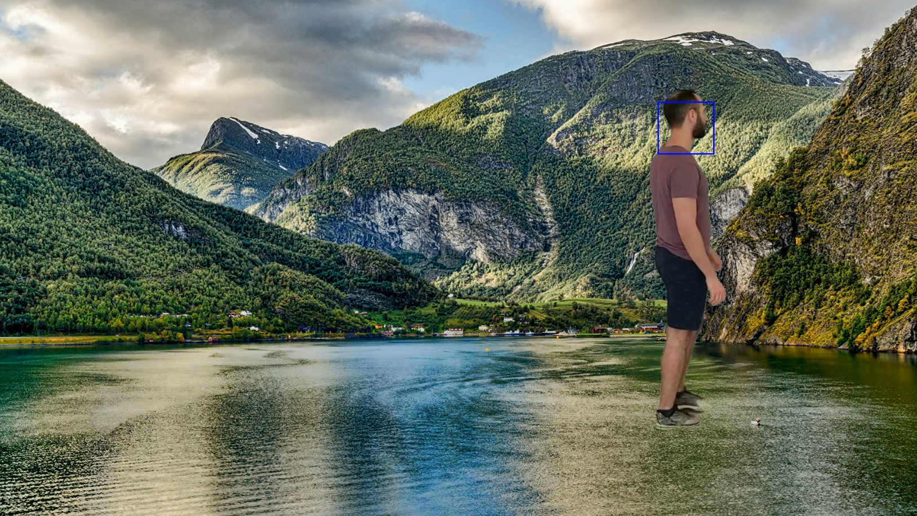
Tracking – second APPROACH
Head selection
Head selection result
Note: As known, MeanShift get poor results while trying to track objects on oclussions scenarios.
Our video does not have occlussions, therefore we find MeanShift suitable for this case.

Slide 30
SUMMARY
Our algorithm finishes the entire process (Stabilization, Background subtraction, Matting and Tracking) in approximatelly 15 minutes.
Through the whole process we maintain high-definition (we never resize or rescaled the input).
No overfitting.
Stages time measurements (measured on Macbook Pro):
Video stabilization: 20 seconds approx.
Background subtraction: 8 minutes approx.
Matting: 5.5 minutes approx.
Tracking: 30 seconds approx.

